Slide 1


USING A TESTING MATURITY MODEL CAN HELP IMPROVE MY TESTING PROCESS?
Thomas C. Staab
Wind Ridge International

Slide 2

CAN USING A TESTING MATURITY MODEL HELP IMPROVE MY TESTING PROCESS???
YES!!!!

Slide 3


WHAT IS A TESTING MATURITY MODEL?

Slide 4

TEST MATURITY MODEL
Establishes a baseline for the current level of testing maturity.
Highlights any inconsistencies between believed level of maturity and actual maturity.
Provides a roadmap for test process improvement.

Slide 5
TEST MATURITY MODELS
Testability Maturity Model (TMM)
Software Testing Maturity Model (SW-TMM)
Test Process Improvement (TPI)
Test Organization Maturity (TOM^{tm})
Testing Assessment Program (TAP)
Proposed Evaluation & Test SW-CMM Key Process Areas (SW-CMM KPA)

Slide 6
TEST MATURITY MODELS
In my opinion there are only two useable in their current format.
  Software Testing Maturity Model (SW-TMM)
  Test Process Improvement (TPI)
I have studied both of these and find the SW-TMM the most useable for my clientele.

Slide 7
MY JUDGMENT CRITERIA
The ease of understanding and use.
Usability by organizations to perform their own assessment.
The ability to provide a baseline and roadmap for improvement.
Ability to repeat assessment to determine progress.

Slide 8
SOFTWARE TESTING MATURITY MODEL
(SW-TMM)
Developed by the Illinois Institute of Technology.
Contains a set of 5 testing maturity levels.
Companion for the Software Capability Maturity Model (SW-CMM).
It promotes testing process improvement and testing professionalism.

Slide 9

SHOULD I USE THE SW-TMM WITH SW-CMM ?
YES!!!!
SW-TMM was designed to be a companion to SW-CMM.
SW-TMM maps to SW-CMM.

Slide 10
SW-TMM PHASES
Level 1 - Initial
Level 2 - Phase Definition
Level 3 - Integration
Level 4 - Management and Measurement
Level 5 - Optimization/Defect Prevention and Quality Control

Slide 11
SW-TMM LEVEL # 1
Testing is a chaotic process.
Ill defined and not distinguished from debugging.
Tests are developed ad hoc after coding is complete.
Objective of testing is to show software works.
Lacks trained staff, resources or tools.

Slide 12
SW-TMM LEVEL # 2
Testing separate from debugging.
Phase after coding.
Primary goal of testing is to show software meets specifications.
Basic testing techniques and methods are in place.

Slide 13
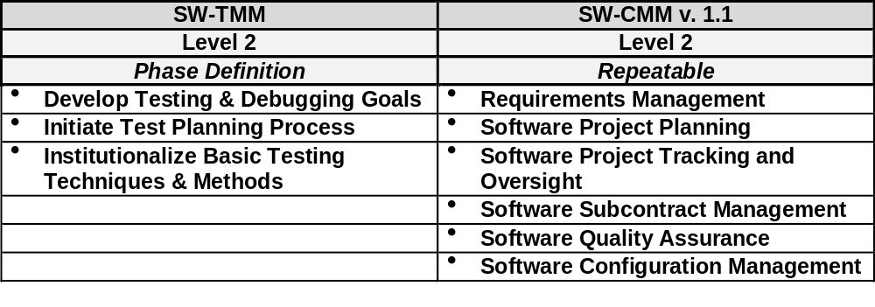
SW-TMM/SW-CMM LEVEL 2 COMPARISON

Slide 14
SW-TMM LEVEL # 3
Testing integrated into entire life cycle.
Test objectives are based on requirements.
Test organization exists.
Testing recognized as a professional activity.

Slide 15
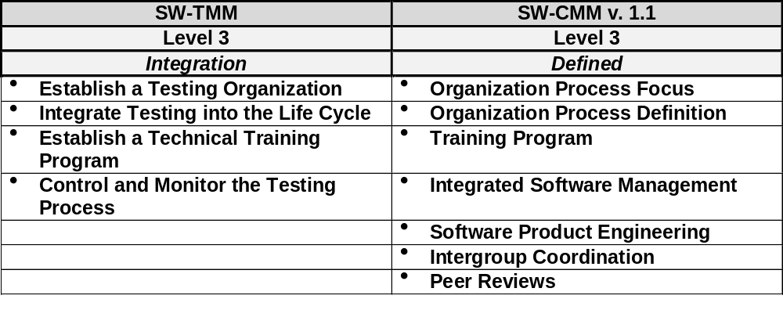
SW-TMM/SW-CMM LEVEL 3 COMPARISON

Slide 16
SW-TMM LEVEL # 4
Testing is a measured and quantified process.
Reviews at all development phases are now recognized as tests.
Products tested for quality attributes, such as, reliability, usability, and maintainability.

Slide 17
SW-TMM LEVEL # 4
Test cases are collected and recorded in a test data base for reuse and regression testing.
Defects are logged and given severity level.

Slide 18
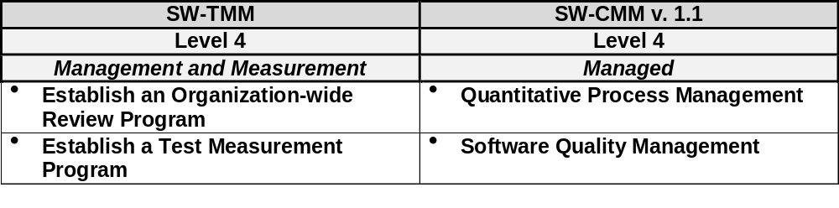
SW-TMM/SW-CMM LEVEL 4 COMPARISON

Slide 19
SW-TMM LEVEL # 5
Testing is defined and managed.
Testing costs and effectiveness can be monitored.
An established procedure exists for the selection and evaluation of testing tools.
Automated tools a primary part of testing process.

Slide 20
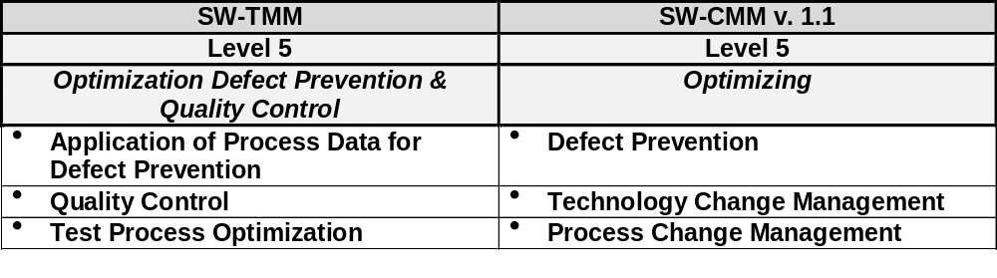
SW-TMM/SW-CMM LEVEL 5 COMPARISON

Slide 21


WHY DO I NEED TO USE IT?
If you are using SW-CMM then you should also use SW-TMM.
SW-TMM is not meant to be used in addition to, but in conjunction with SW-CMM.

Slide 22
WHY DO I NEED TO USE IT?
Even if you are not using SW-CMM then you can benefit from SW-TMM.
You may think you know your testing maturity, but I bet you really don’t.

Slide 23


WHY DO I NEED TO USE IT?
You can’t make improvements unless you can show management that the process needs improving.
Need a roadmap to help make incremental improvements.

Slide 24
WHAT MAKES SW-TMM AN EXCELLENT COMPANION?
Provides methodology to baseline current test process maturity.
Designed to guide the selection of process improvement strategies.
Designed as an evolutionary path.

Slide 25

WHAT MAKES SW-TMM AN EXCELLENT COMPANION?
Provides a roadmap for continuous process improvement.
Provides a method for measuring progress.
Helps satisfy activities 5,6,7, and 9 in level 3 under KPA Software Product Engineering.

Slide 26


HOW DO I USE IT?
Secure management support to perform the assessment.
Assess your current testing process.
Document your current maturity level.
Develop and implement an improvement plan.
Repeat the assessment to demonstrate that improvements have been made.

Slide 27

CAN WE ASSESS OUR MATURITY ON OUR OWN?
YES, but it might be best the first time to hire a consultant to lead you through it.
A consultant cannot perform the assessment for you.
In order for the process to be successful, the organization must feel ownership.

Slide 28

WHAT WILL THE ASSESSMENT ACCOMPLISH?
Baseline the current testing maturity.
Identify testing processes that need improvement.
Identify testing processes that could be adopted company-wide.
Provide documentation to support the findings to management.

Slide 29
HOW DO WE CONDUCT THE ASSESSMENT?
If you are using SW-CMM, then the assessment is performed with the Software Capability assessment.
If not using SW-CMM, then a stand-alone testing assessment needs to be performed.

Slide 30
QUESTIONS TO ASK DURING THE ASSESSMENT?
Are we doing the right process?
Are we doing the process right?

Slide 31

WHAT TOOLS WILL BE USED IN THE ASSESSMENT?
Presentations by organizations being assessed.
Questionnaire.
Personal Interviews.
Document reviews.
Documenting the current testing process.

Slide 32

USING A TESTING MATURITY MODEL CAN HELP IMPROVE MY TESTING PROCESS!!!

Slide 33
USING A TESTING MATURITY MODEL WILL -
Help attain the next SW-CMM level.
Baseline the current testing process.
Identify areas that can be improved.

Slide 34
USING A TESTING MATURITY MODEL WILL -
Identify testing processes that could be adopted company-wide.
Provide a roadmap for implementing improvements.
Provide a method for measuring improvement results.

Slide 35

CONTACT INFORMATION
Thomas C. Staab
Wind Ridge International
11321 E. Folsom Point Lane
Franktown, CO 80116-9105
303.660.3451
303.660.2057 fax
wind.ridge@att.net

